Slide 1
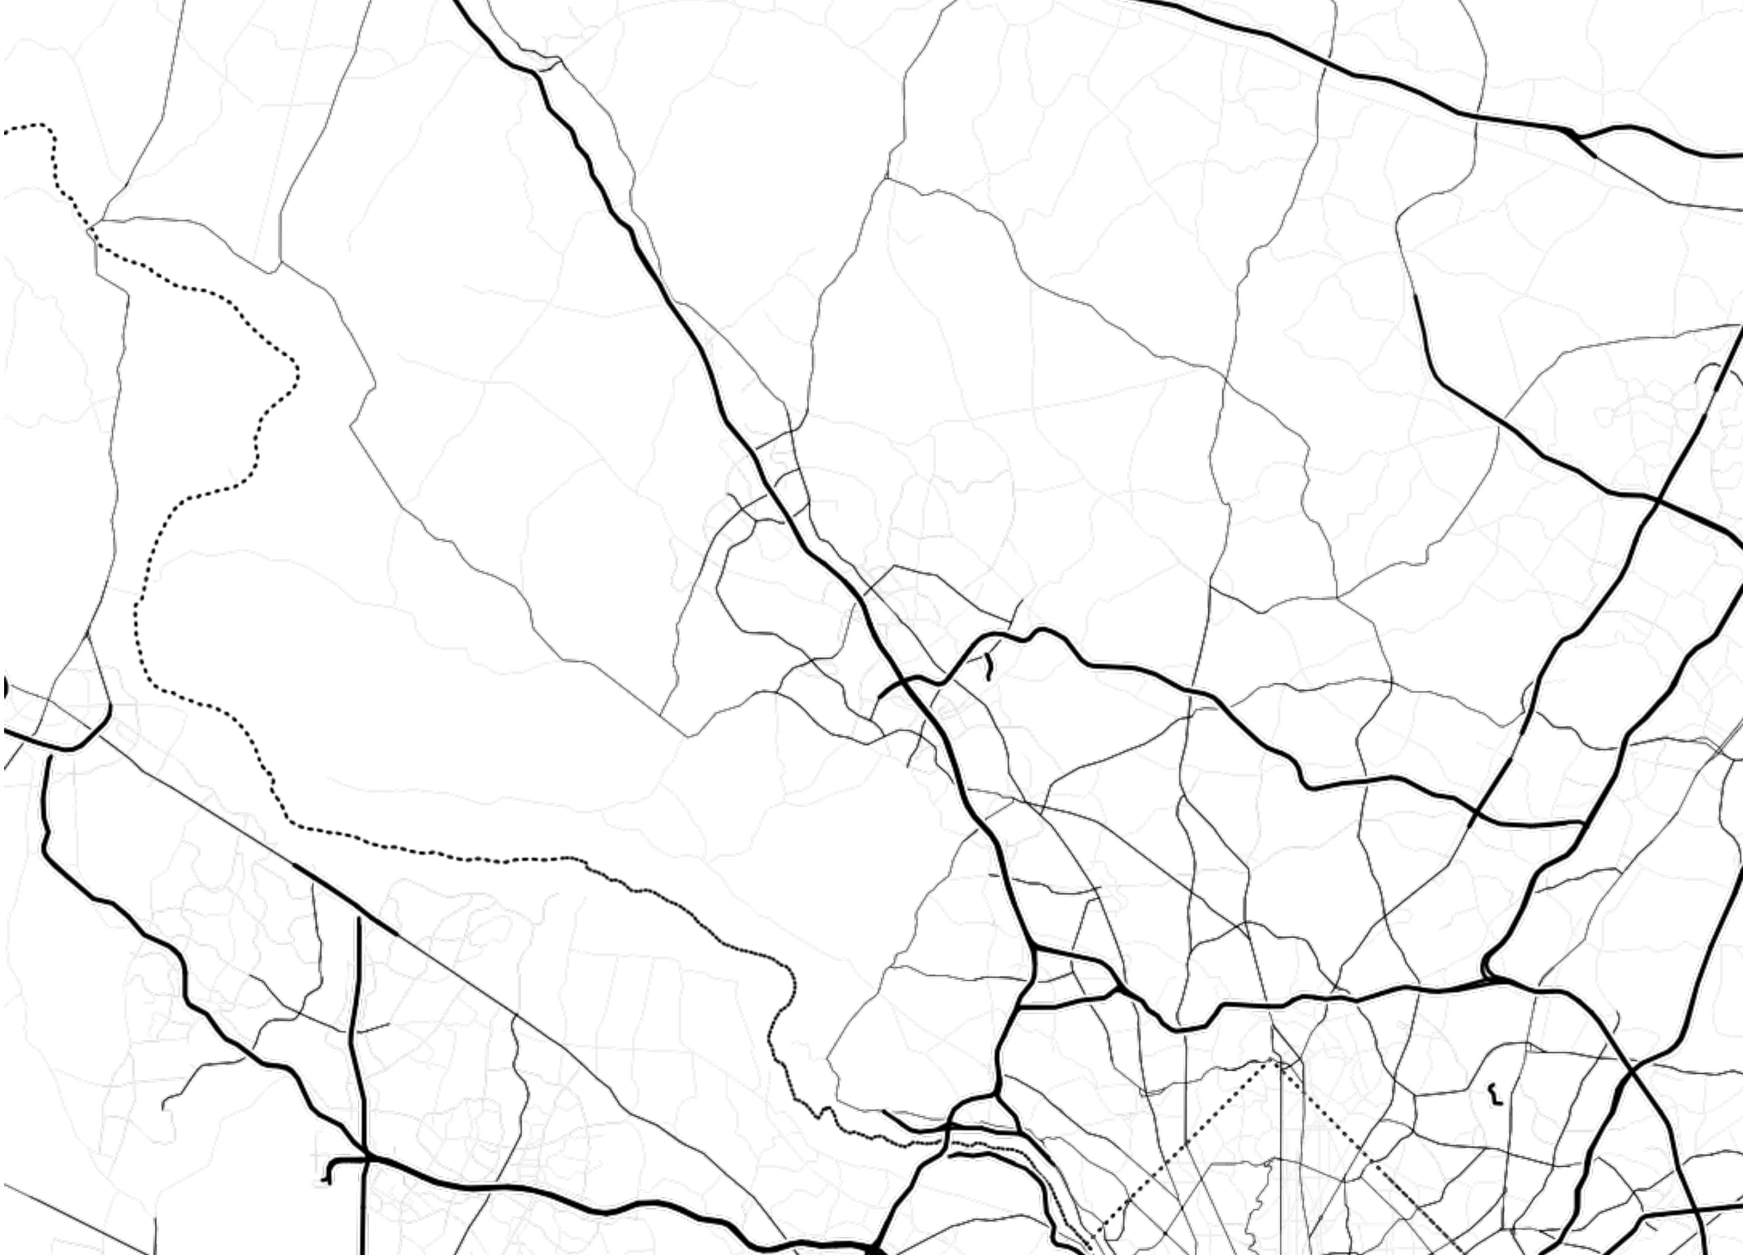
Montgomery County Traffic Incidents
Michael Metzler

Slide 2
Data Sets
Automated Crash Reporting System (ACRS)
Police Records of traffic collisions since January 1st 2015
Incidents
58,131 incidents recorded
Drivers
103,691 drivers involved
Non-Motorists
3,284 non-motorists involved

Slide 3
Quick Numbers
146 Fatal Incidents
71 Drivers, 64 Non-Motorists
20,787 Injury Incidents
1,243 Serious Injuries
876 Drivers, 367 Non-Motorists
37,198 Property Damage Incidents
4,081 Vehicles Destroyed, 36,731 Disabled
3,274 Incidents involving Alcohol

Slide 4
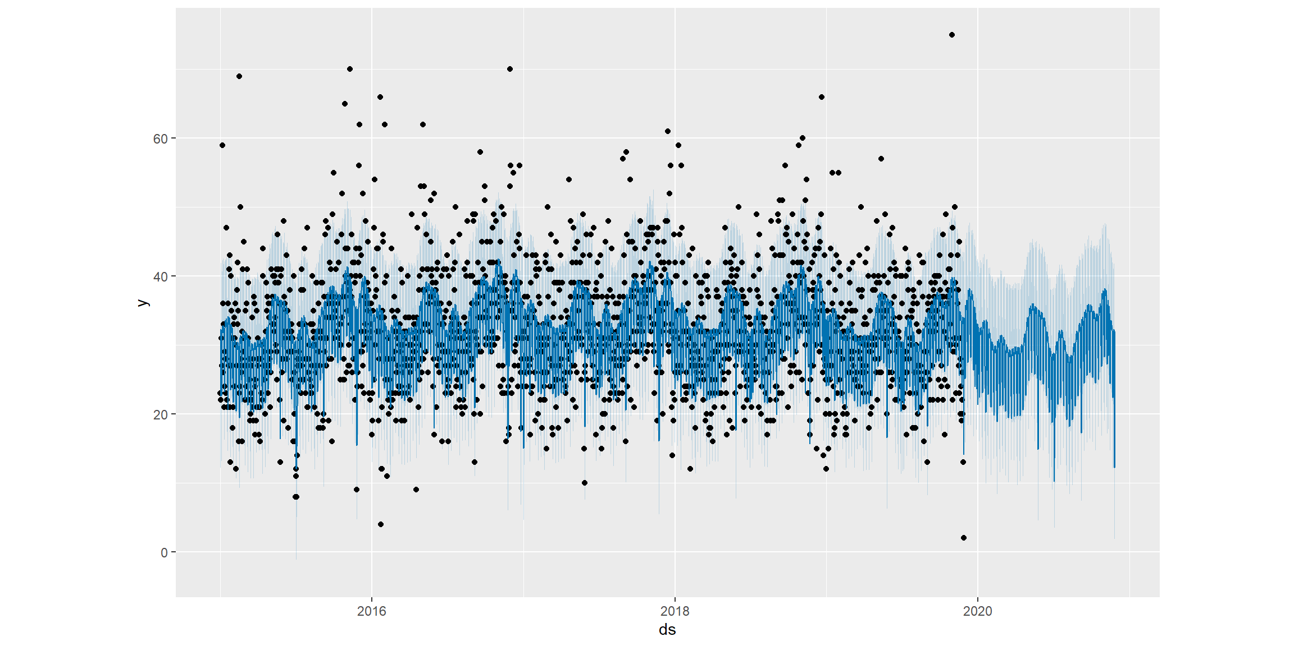
Forecasting Collisions

Slide 5
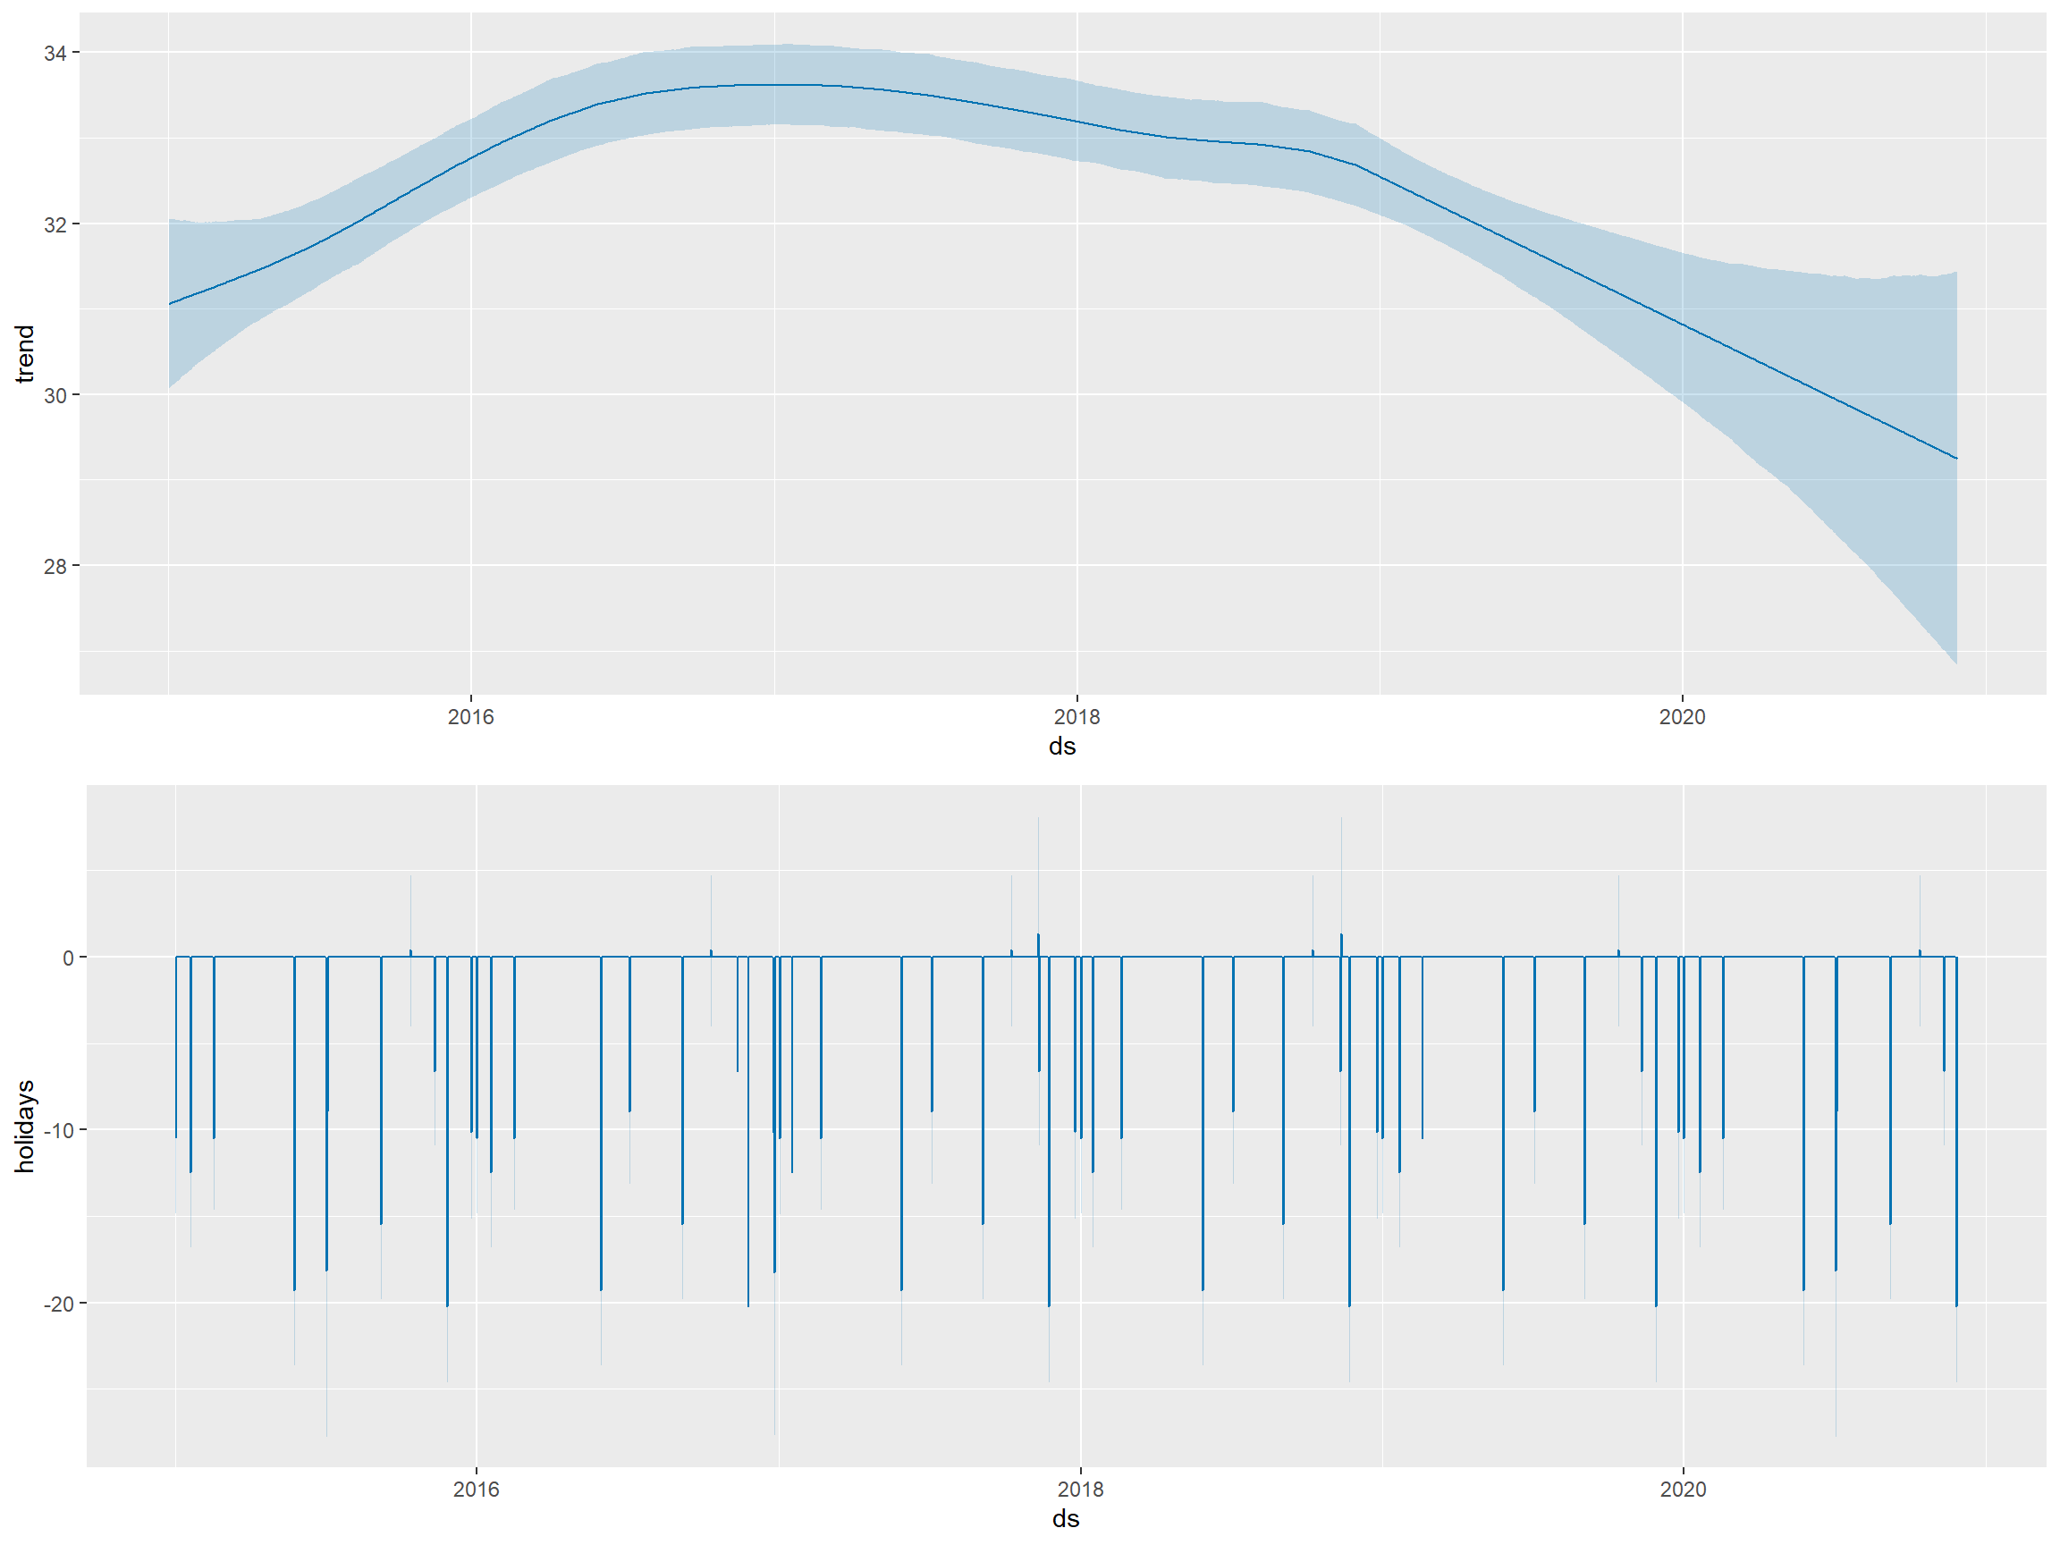
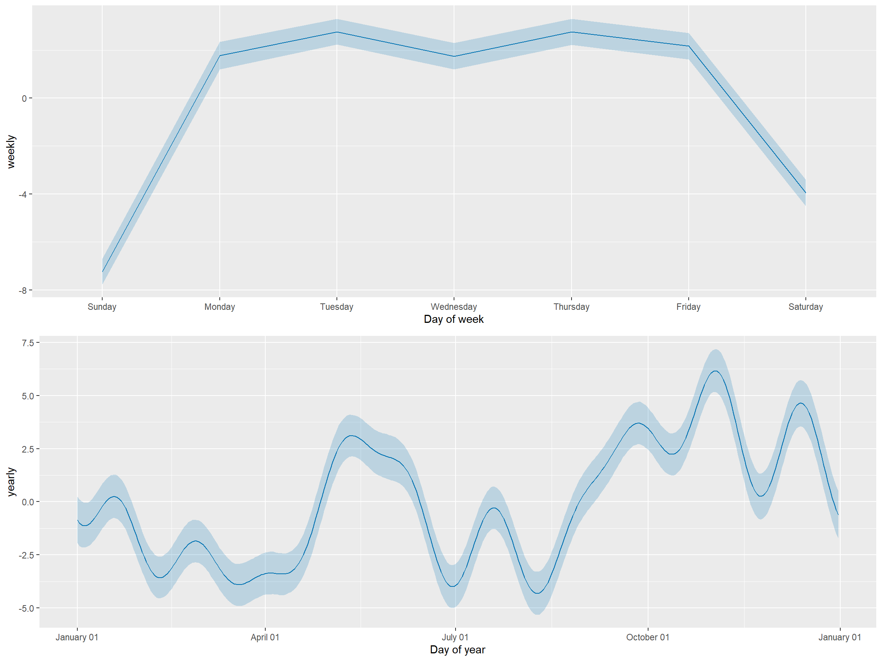
Trends in Collisions

Slide 6
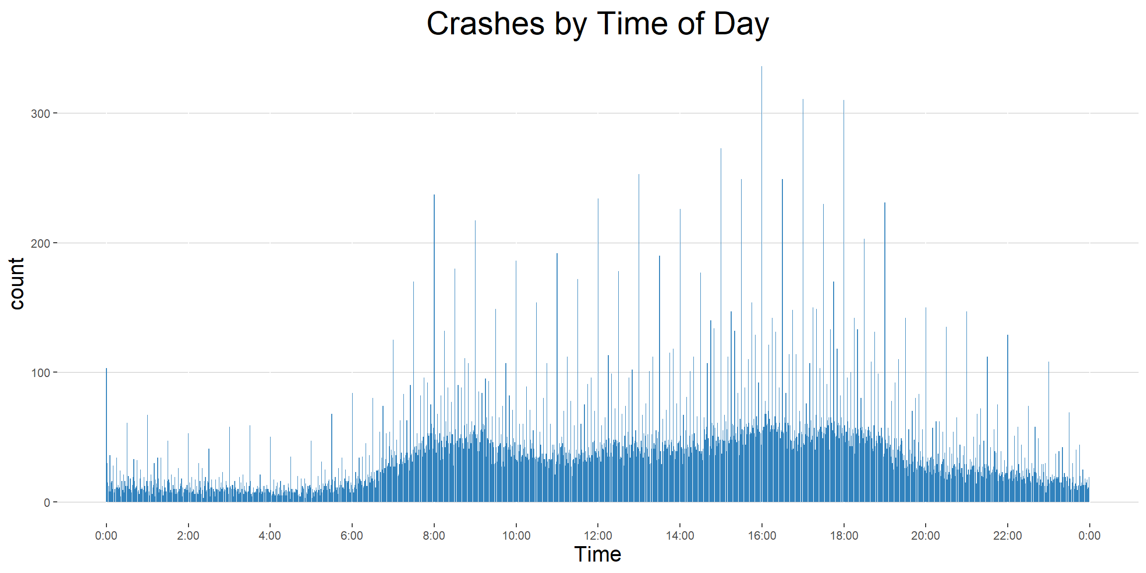

Slide 7
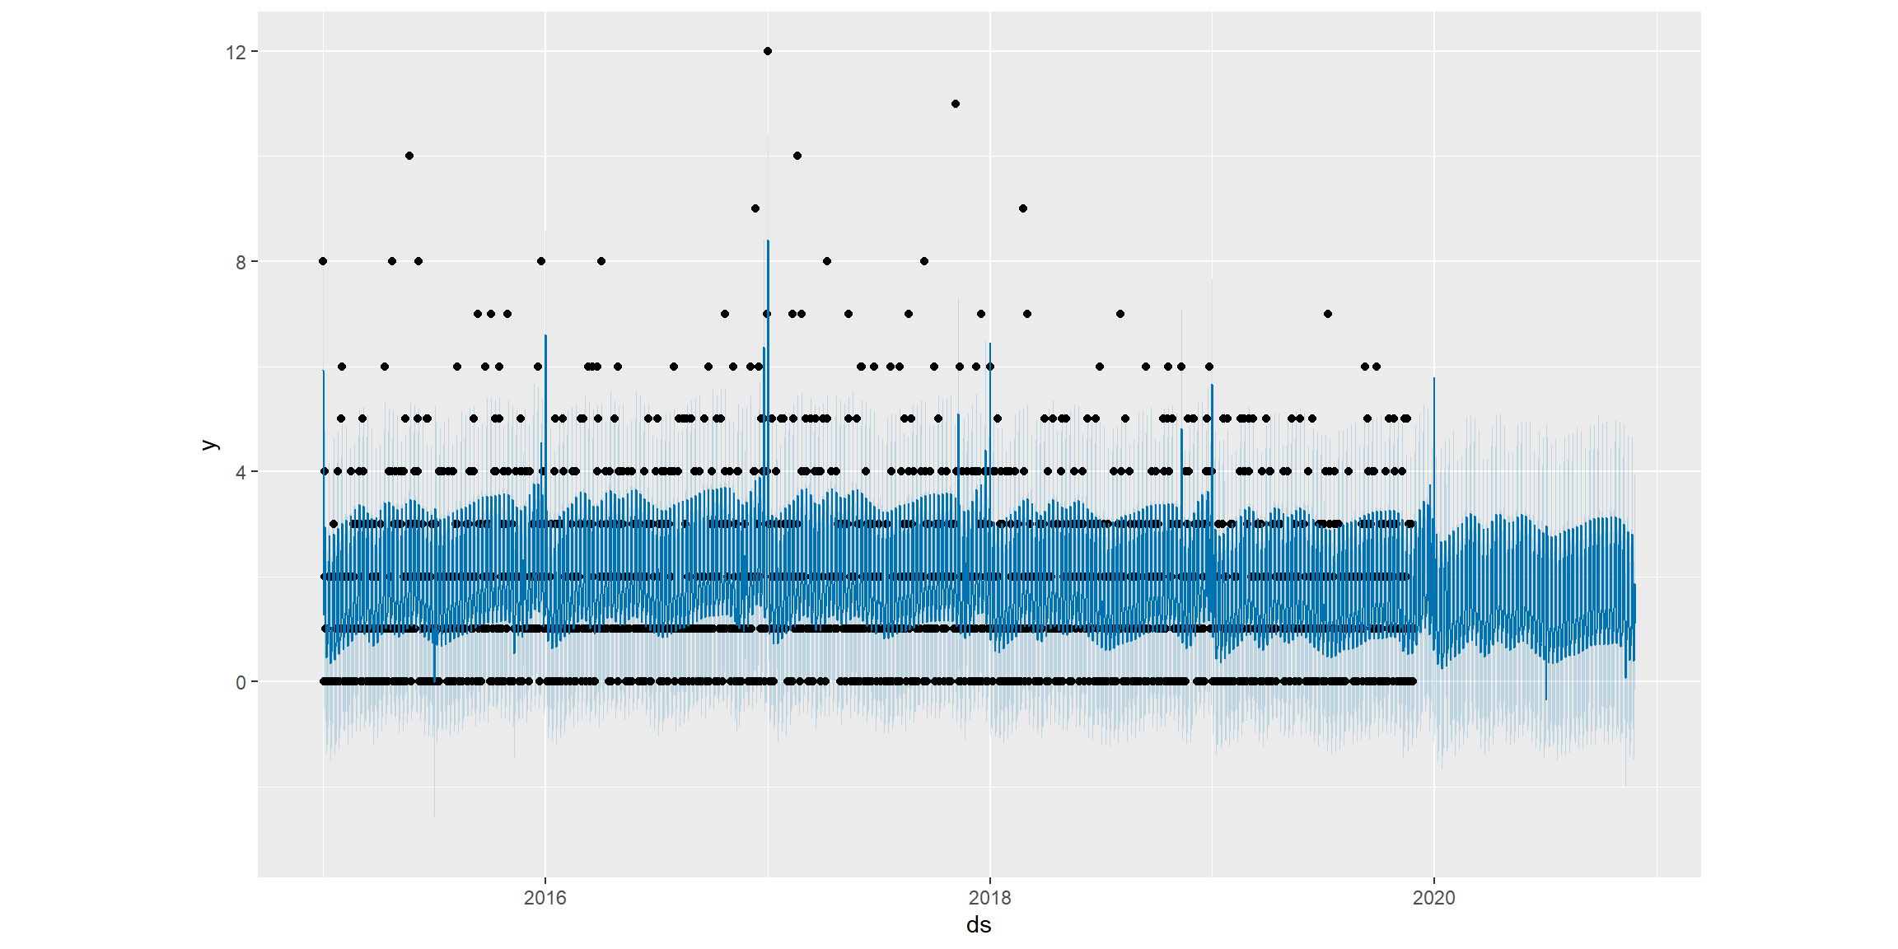
Forecasting Alcohol Related Collisions

Slide 8
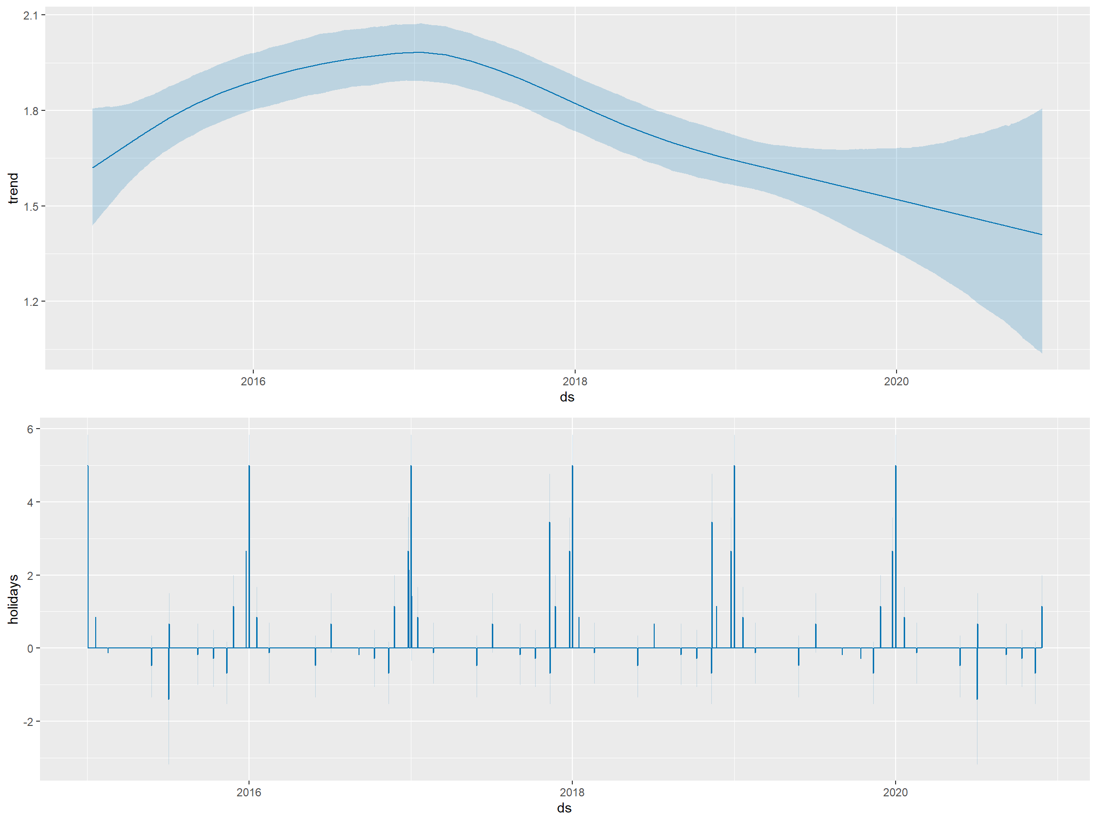
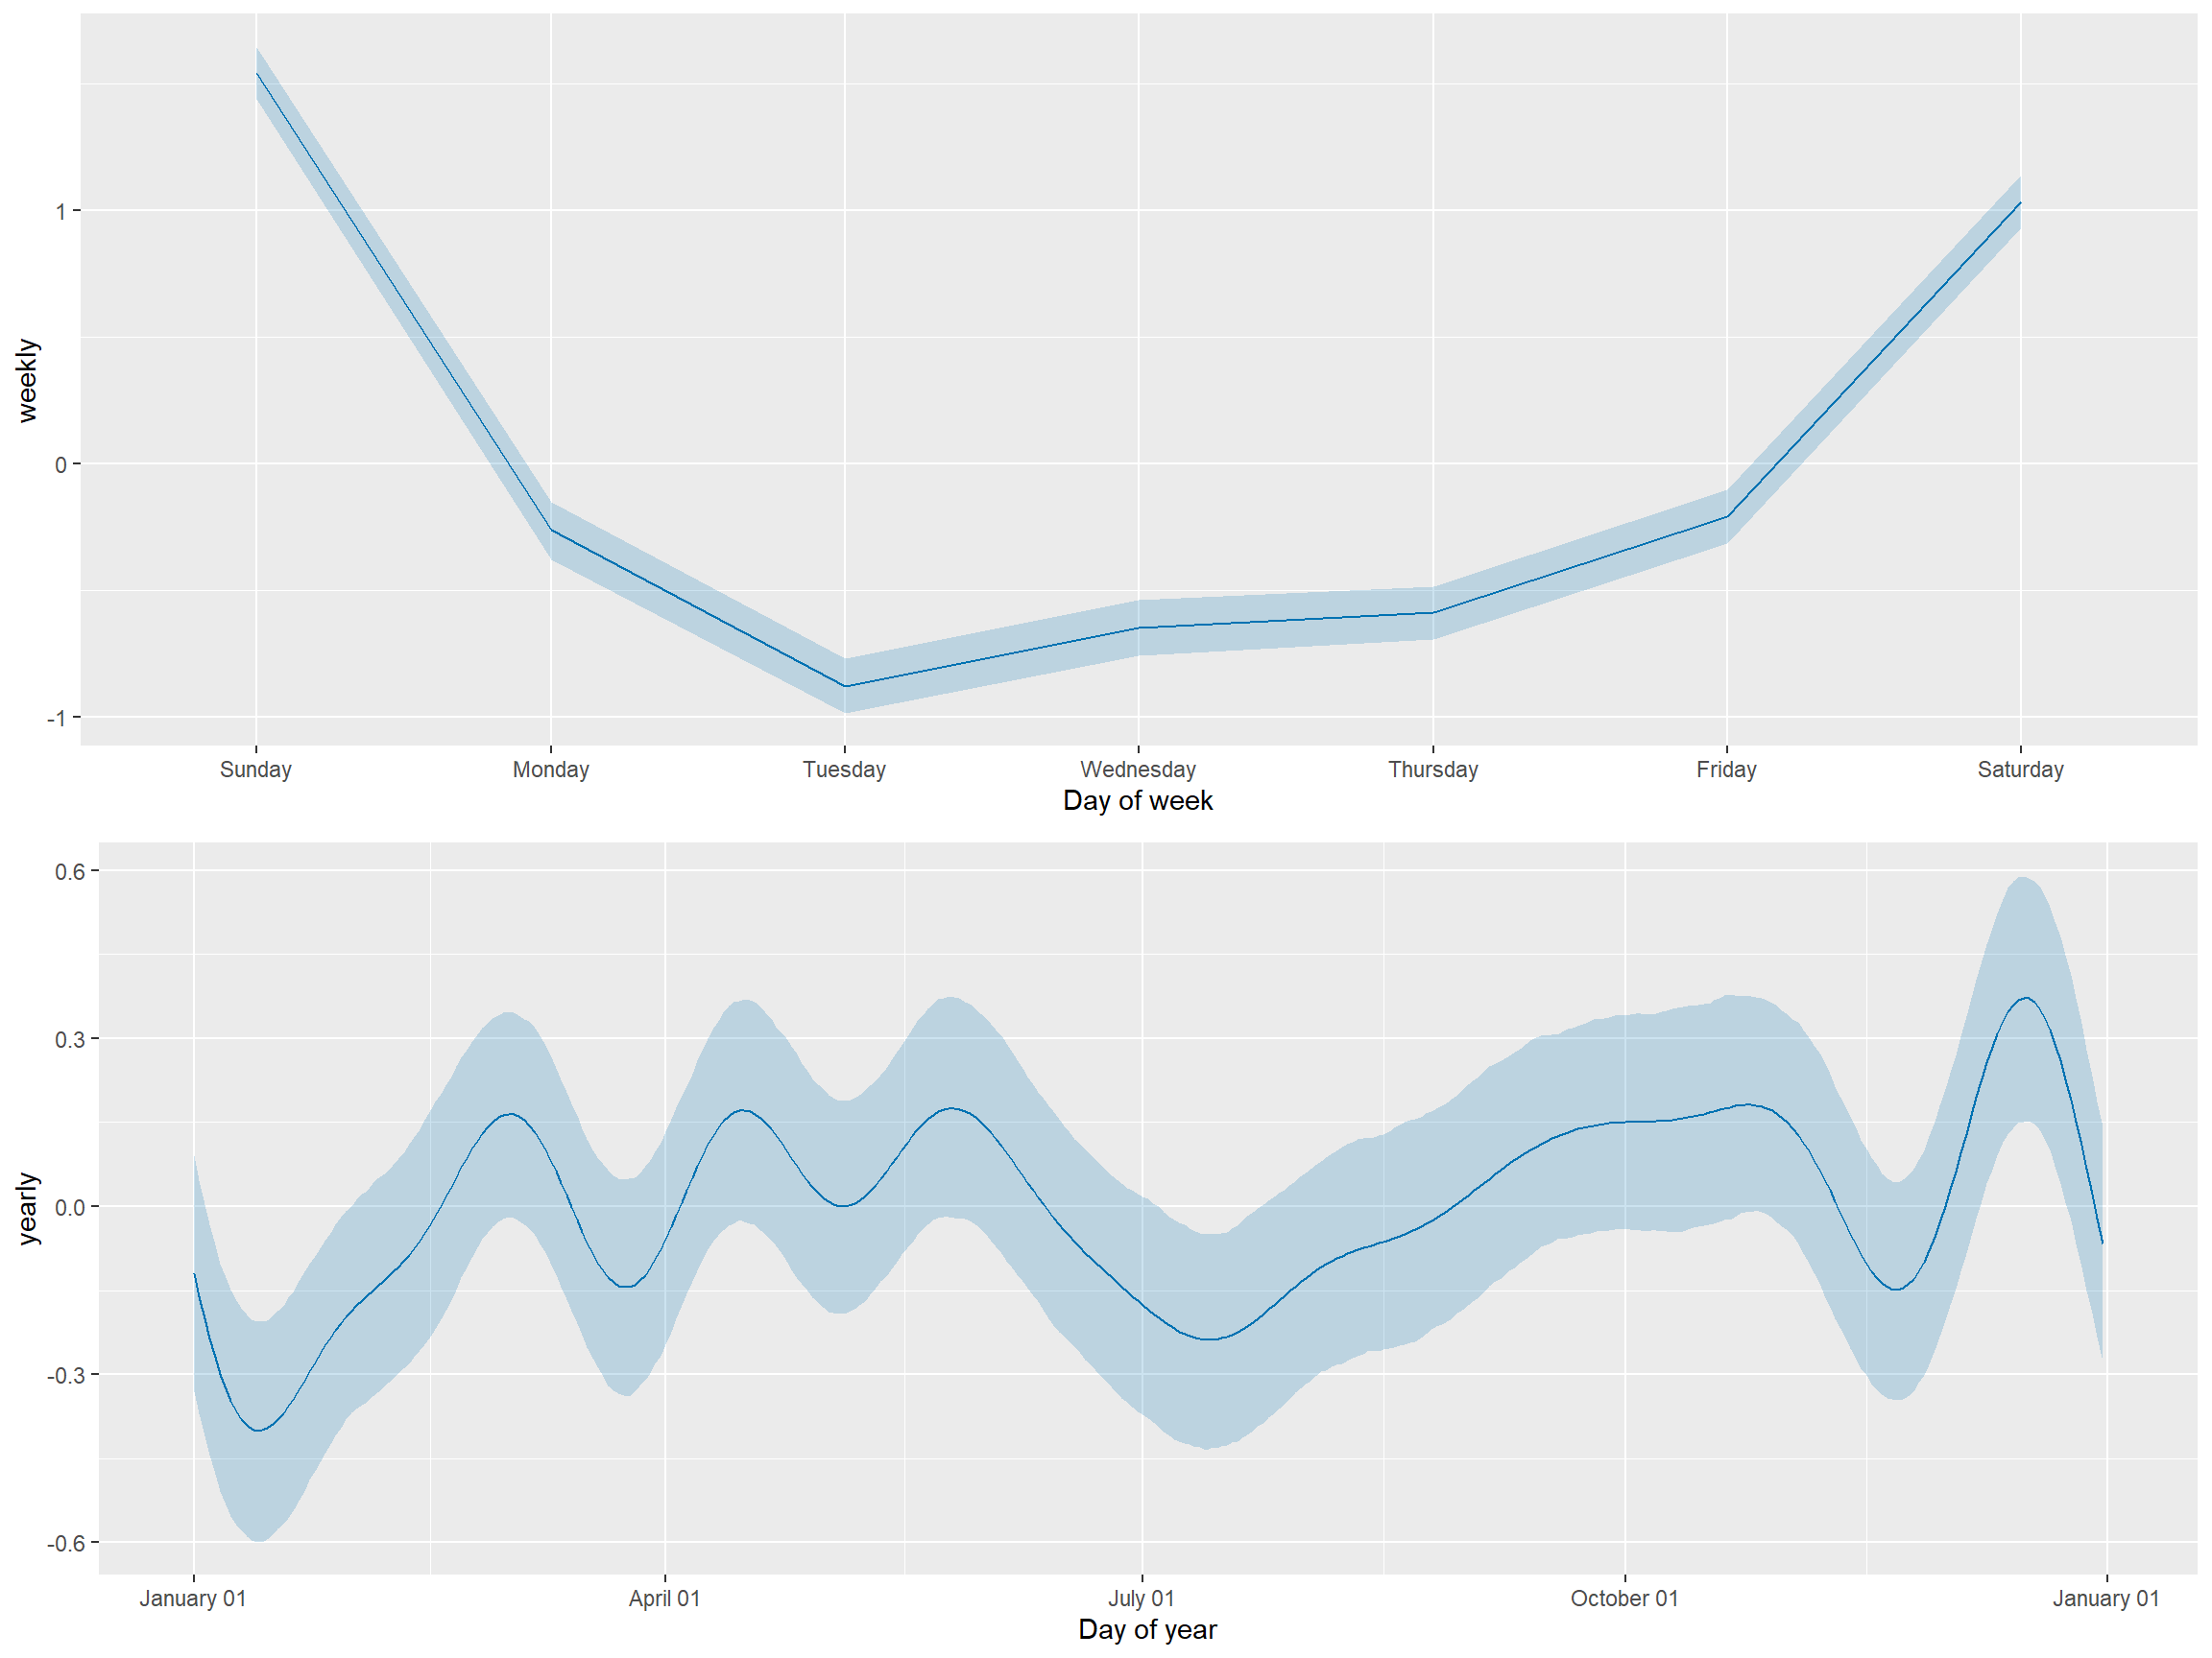
Trends in Alcohol Related Collisions

Slide 9
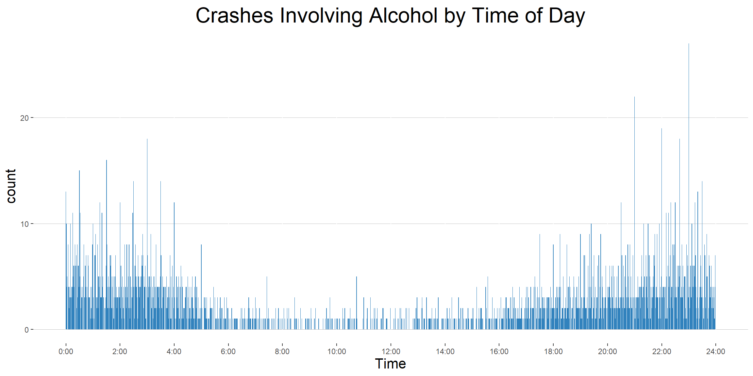

Slide 10
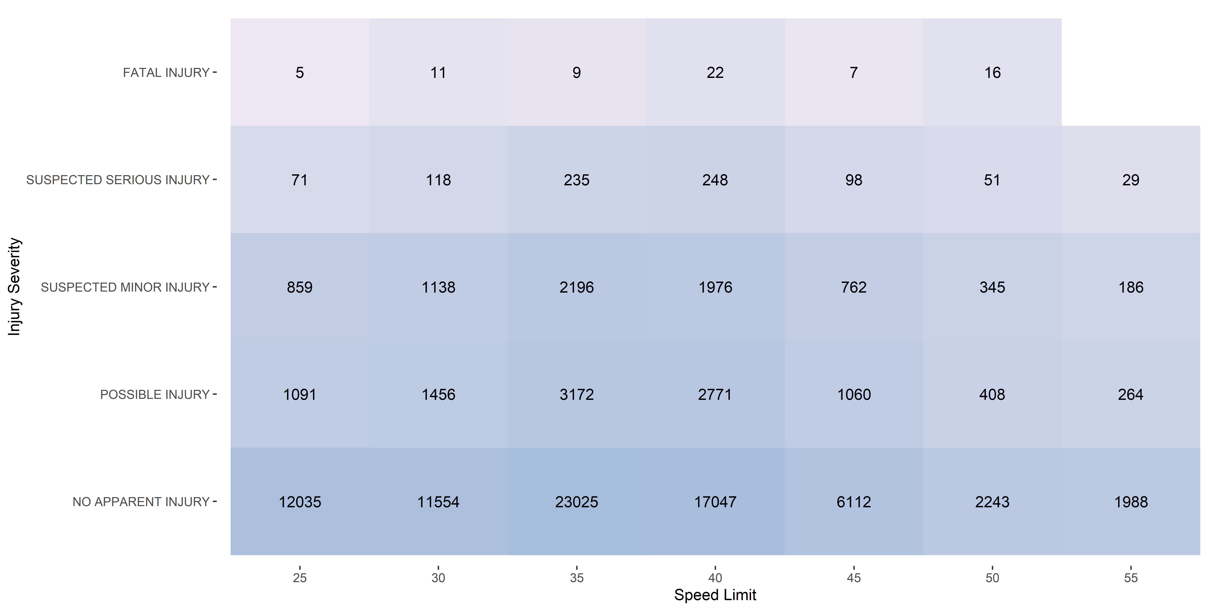
Speed Limits and Driver Fatalities

Slide 11
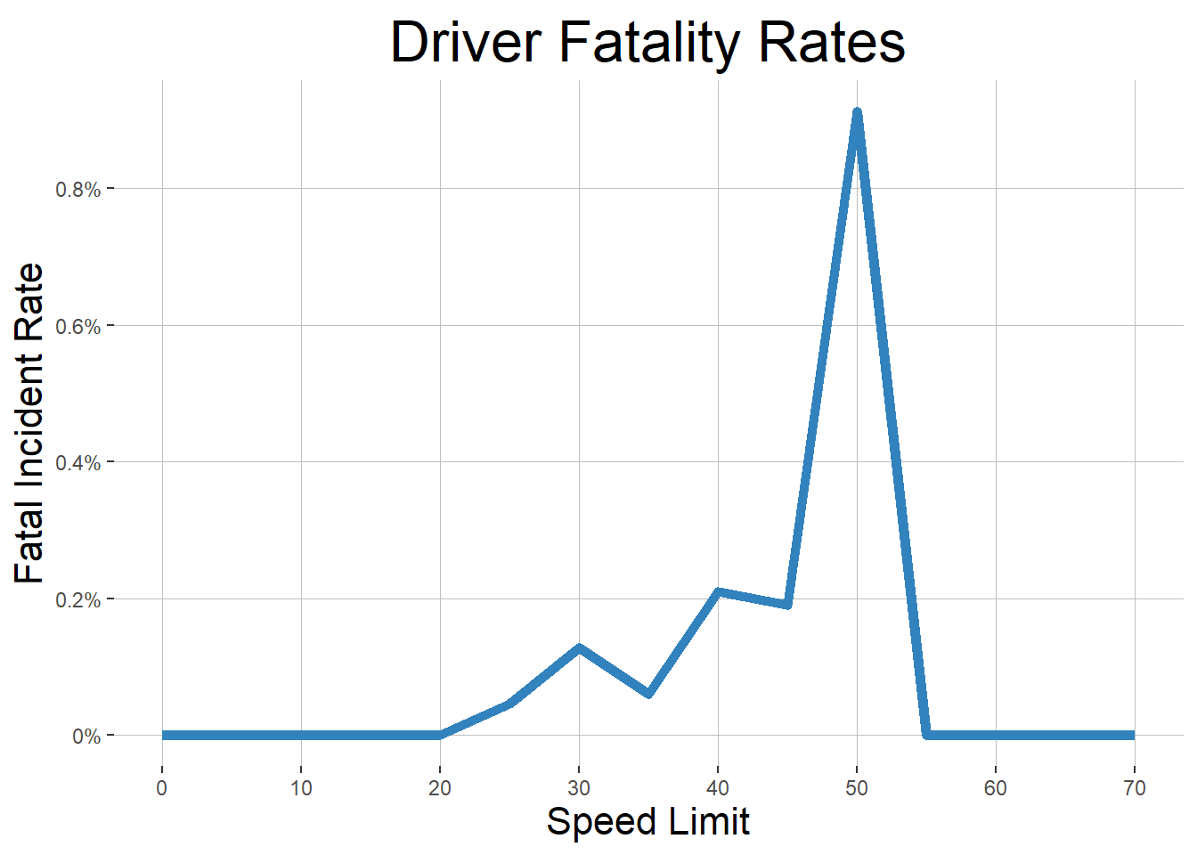

Slide 12
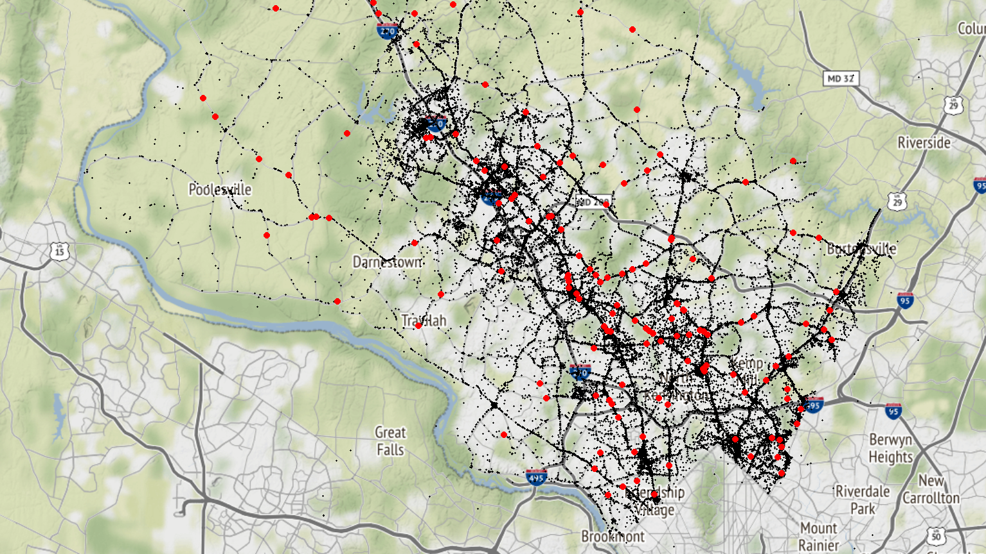

Slide 14
Acknowledgements
Montgomery County Government and dataMontgomery
Dennis Linders
Victoria Lewis
Montgomery College Data Science Program
Professor Mohamed
Professor Saidi
Professor Linehan

